Slide 1
Photoresistor Sun Sensor Experiment
By: Noah K. Stokely
NASA Space Grant – ASCEND!
Mentors: Dr. Ronald Madler, Jack Crabtree
April 17, 2010

Slide 2
Overview
Project Goals
Hardware Description/Operation
Flight Results
Future Work
Questions

Slide 3
Project Goals
Determine the orientation of the payload
Develop more of an understanding of the dynamics of a balloon flight
Prove the usability of photoresistors as sensors
4/17/2010

Slide 4
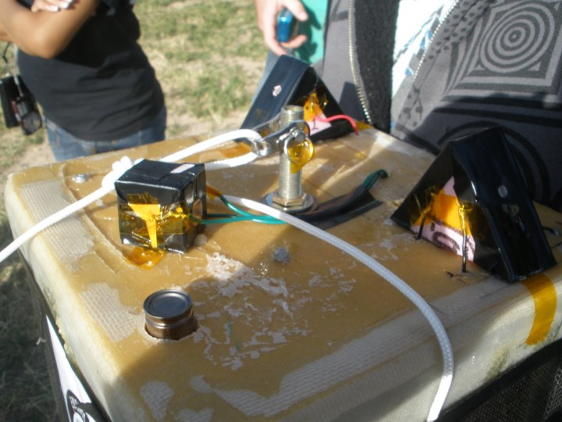
Hardware Description
Six photoresistors mounted flush with the surfaces of two wedges and one cube. Oriented on the surface such that azimuth and elevation angles can be found.
4/17/2010

Slide 5
Operation
+5V
R
R
GND
If both photoresistors see equal light intensity, the voltage reading will be 2.5V.
Depending on the orientation of the wedge, the voltage reading will fluctuate linearly about 2.5V.
Voltage reading will allow for the angle determination with respect to the sun.
To ADC In
70º
Photoresistor

Slide 6
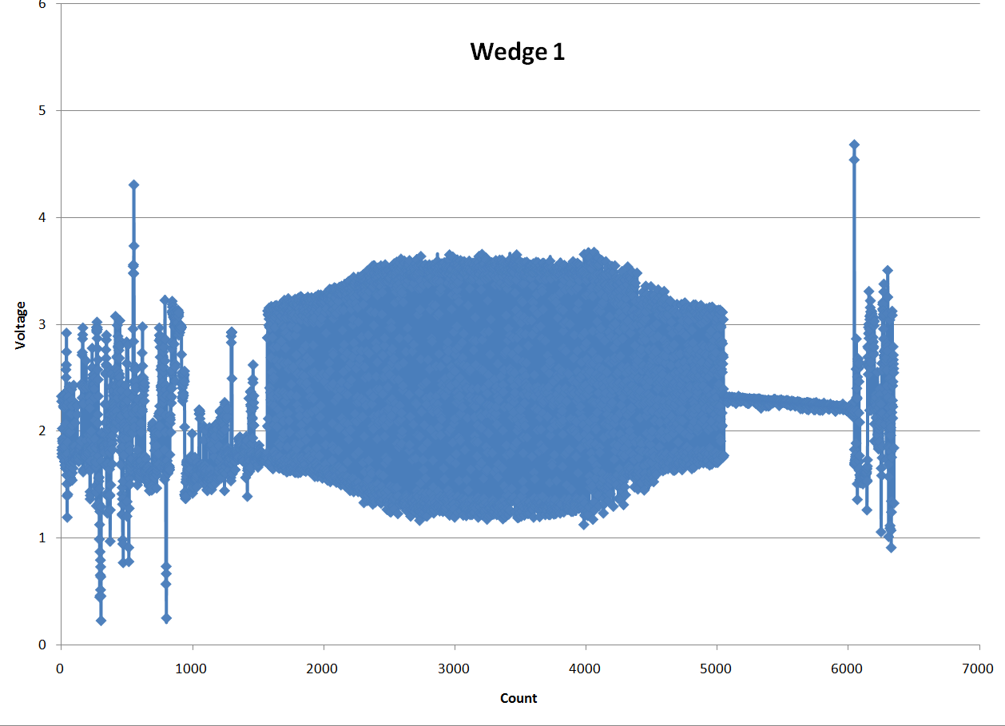
Flight Results

Slide 7
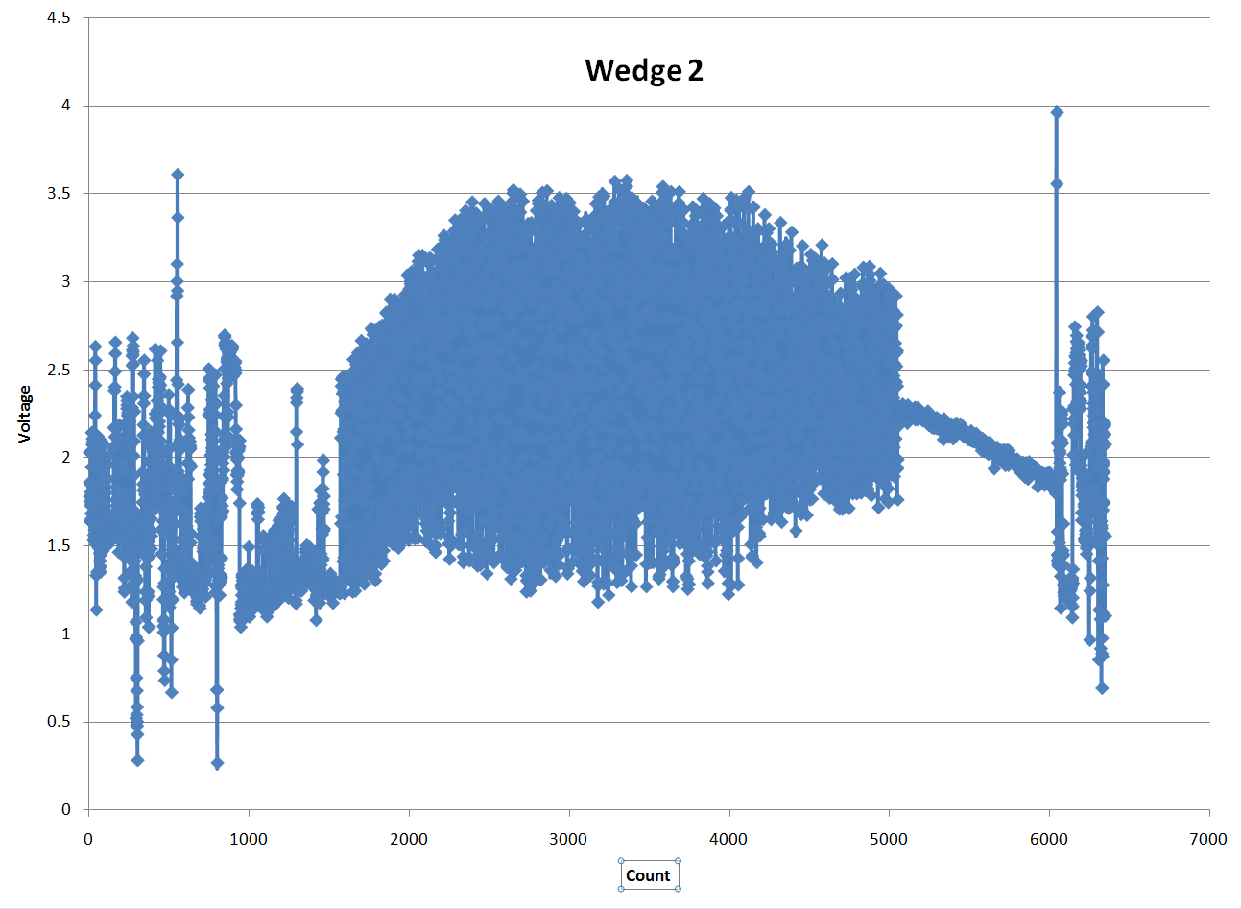
Flight Results

Slide 8
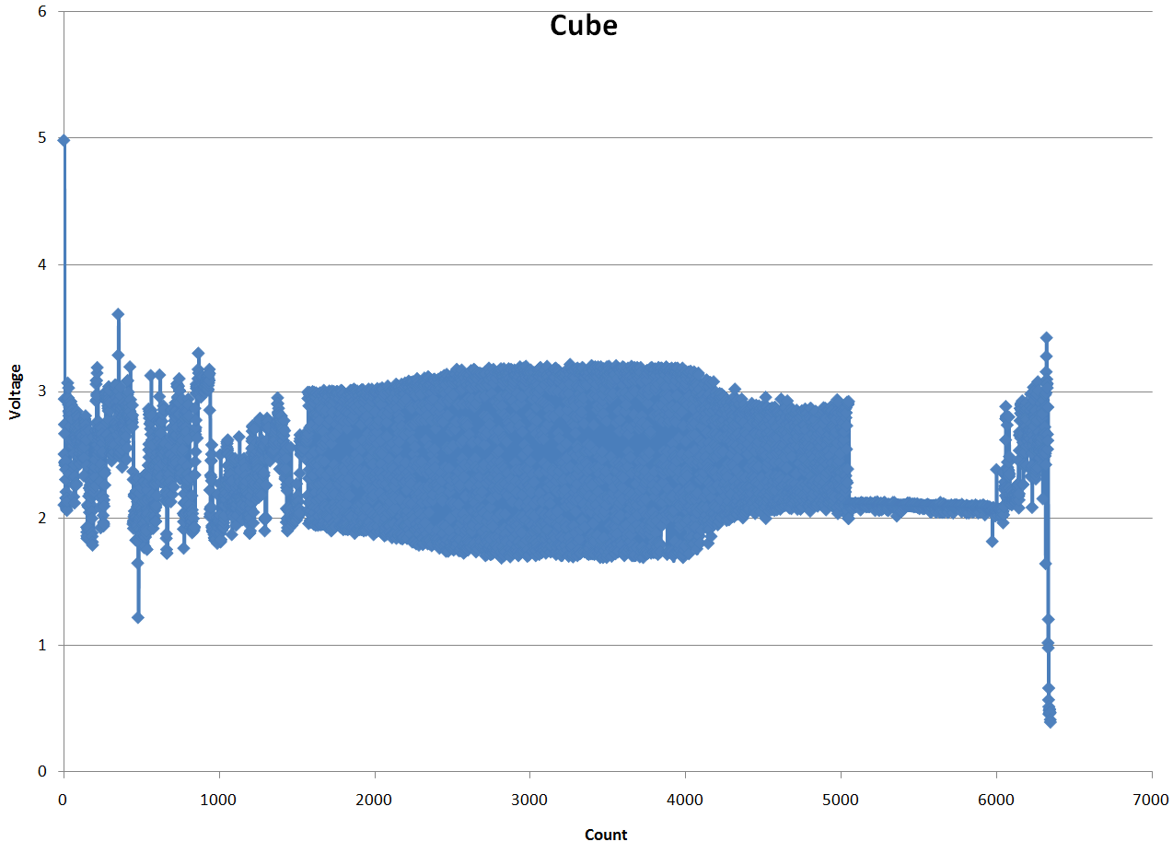
Flight Results

Slide 9
Future Work
Further analyze the data and continue to develop a MATLAB algorithm to read in the data and determine an payload orientation for each point.
Use an Fast Fourier Transform on the flight data to see the dominating oscillation frequency of the azimuth angle.
Implement an accelerometer to develop an understanding of the g-forces during flight.

Slide 10
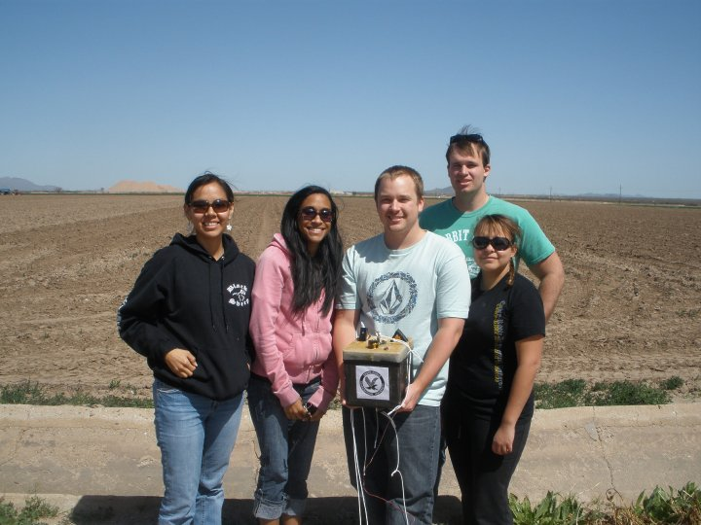
QUESTIONS??

